Slide 1

Toward Super High-Level SDN Programming
Yale University
Nov. 14-17, 2016

Slide 2



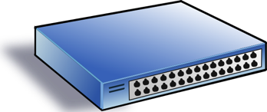
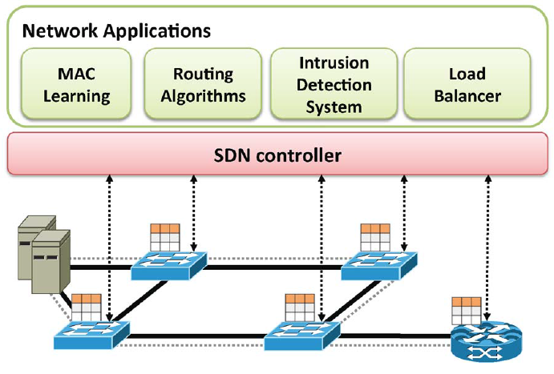
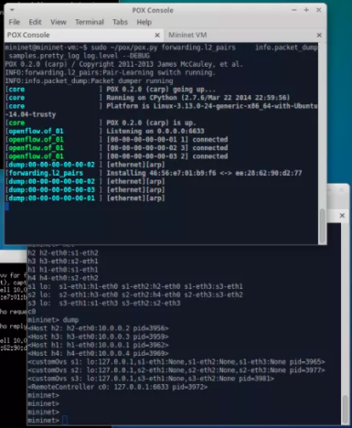
Challenges
programming to fill the gap
logically centralized data store
Network State
Declarative Policy
Net Elem Datapath
Net Elem Datapath
Challenge1:
OpenFlow is a low level, complex computation model. However…
Control Plane :
OpenFlow
Flow table
Data Plane
Challenge 2:
Complex manual tracking of execution dependency
Manual cleanup, re-execute
Notes:
1.Complex, split programming model
(OpenFlow is a low level, complex computation model: it does not even support logic negation, and hence needs priority to simulate logic negation, it supports only layer 2 to layer 4, but many decisions may depend on higher layers )
2.Network dynamics(Complex manual tracking of execution dependency Manual cleanup, re-execute)

Slide 3
Our Solution(New SDN Programming Tools)
Old SDN programming Modal
Super High-level SDN programming Modal
Ops Level
Step 1. Make Decisions
Step 1. Make Decisions
Ops Level
Step 2. Generate Rules
Step 2. Generate Rules
Controller Library
OF Controller Library
Under the hood
Under the hood
Switches
OF Switches
WebIDE
FAST
Real Switch
Real Switch
Maple
Simple SDN
programming environment
Automatic data dependence and re-execute
Hight-level programming

Slide 4
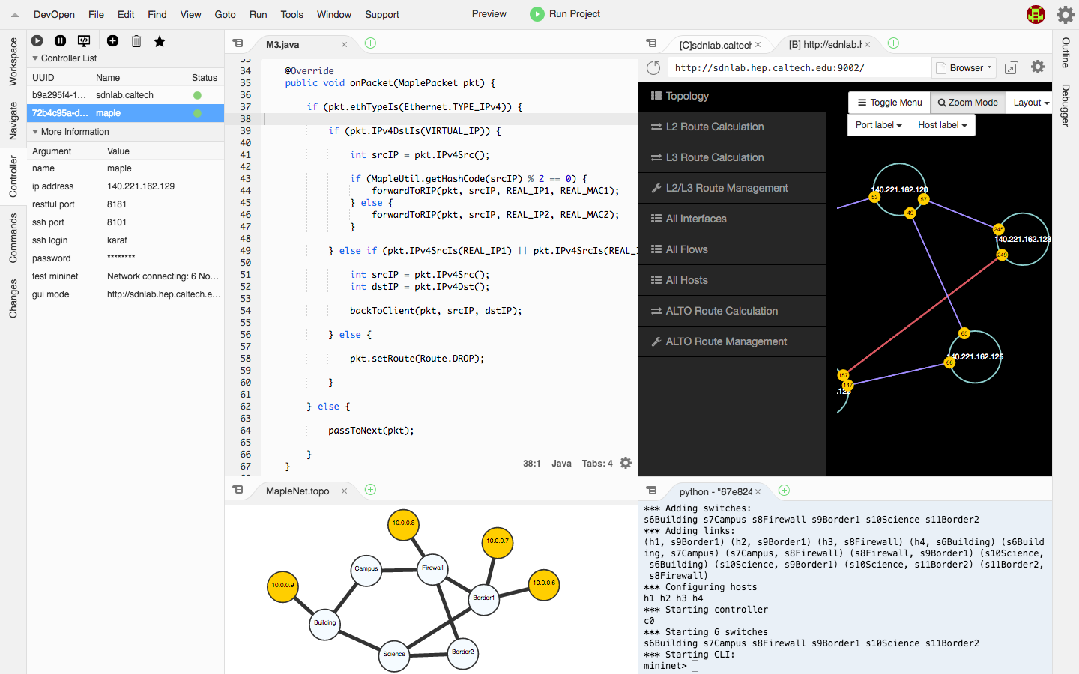
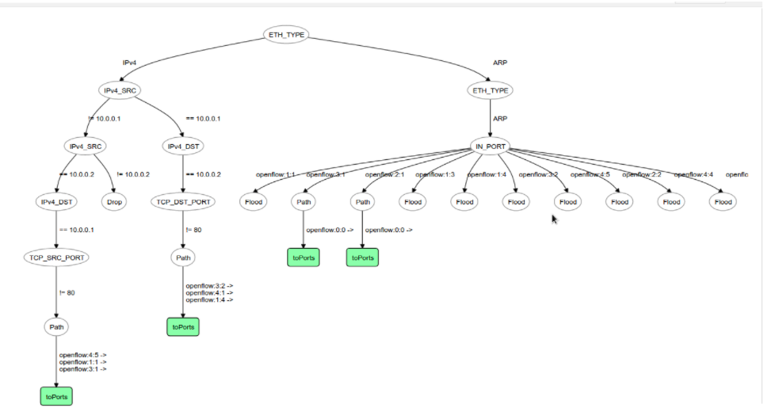
WebIDE(Simple SDN programming environment)
Web-based automatic generation of projects
Programmer focuses only on key aspect(like policy)
One-click deployment
_{Automatic} generate visualized trace tree
SDN Controller Information Management
Web-based UI for real network operation
Write Maple program in web-based editor easily
Mininet based tools for network test

Slide 5
Maple(high-level, all-layer programming)
High-level, completely south-bound agnostic, cross-layer (L2-L7) programming
Programmer sees (logically) each and every packet
Integrated access control supporting per-user or role based programming
1. private static final String[] H12_TAP = { H1, "openflow:1:2", "openflow:2:1" }​
2. private static final String[] H12_ONE = { H1, "openflow:1:2", "openflow:2:3", "openflow:4:1" }​
3. private static final String[] H12_TWO = { H1, "openflow:1:3", "openflow:3:2", "openflow:4:1" } ​
4.​void f(Packet pkt) {​
5. int srcIP = pkt.srcIP; int dstIP = pkt.dstIP;​
6. String flowId = computeFlowId( srcIP, dstIP, pkt.srcPort, pkt.dstPort, pkt.protocol );​
7. if ( srcIP == H1 && dstIP == H2 ) {​
8. FlowMetadata fm = getFlowMetadata(flowId); ​
9. if ( fm == null ) { ​
10. pkt.addRoute( H12_TAP );​
11. pkt.addRoute( H12_ONE );​
12. } else if ( isVideo( getUri( fm ) ) ) {​
13. pkt.addRoute( H12_TWO );​
14. } else pkt.addRoute( H12_ONE );​
15. } else if ( srcIP == H2 && dstIP == H1 ) {​
16. …​
17. } else pkt.addRoute( Route.drop );​
18. }​
Per-packet
programming
model
Meta header to
control cross
layers
South-band
agnostic
Does not specify anything on flow tables!

Slide 6
FAST(automation function store)
Automatic execution MapleApp dependency tracking
Automatic cleanup, re-execution MapleApp (intent ++)
Host generic network functions

Slide 7
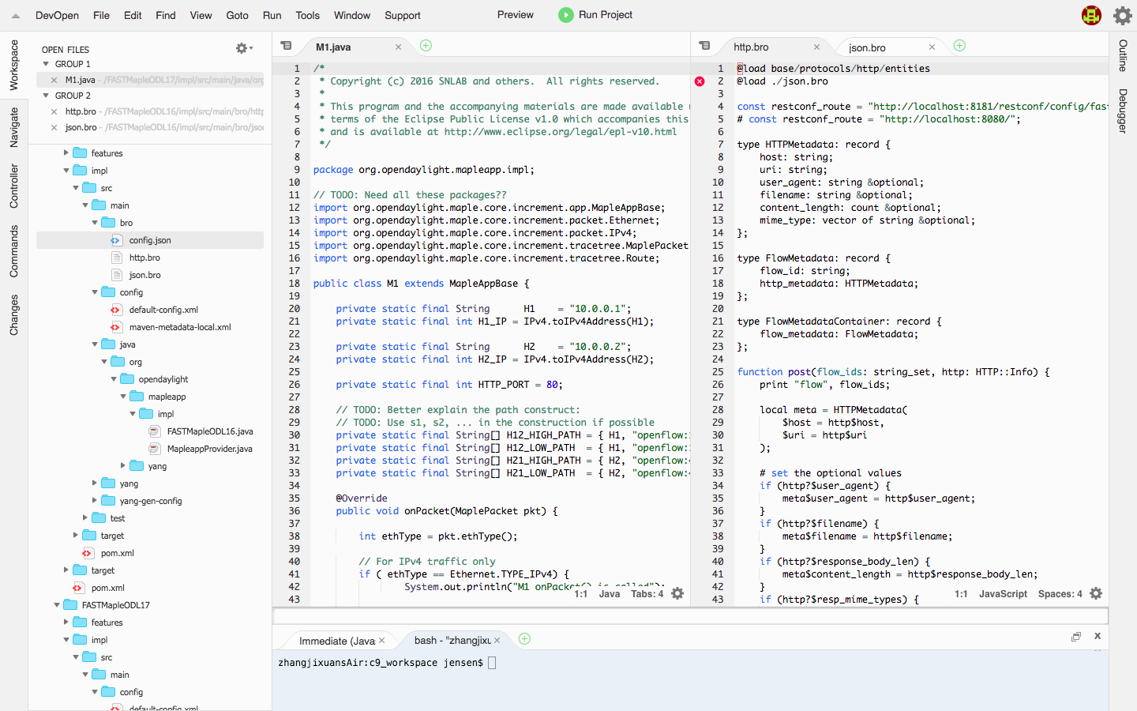
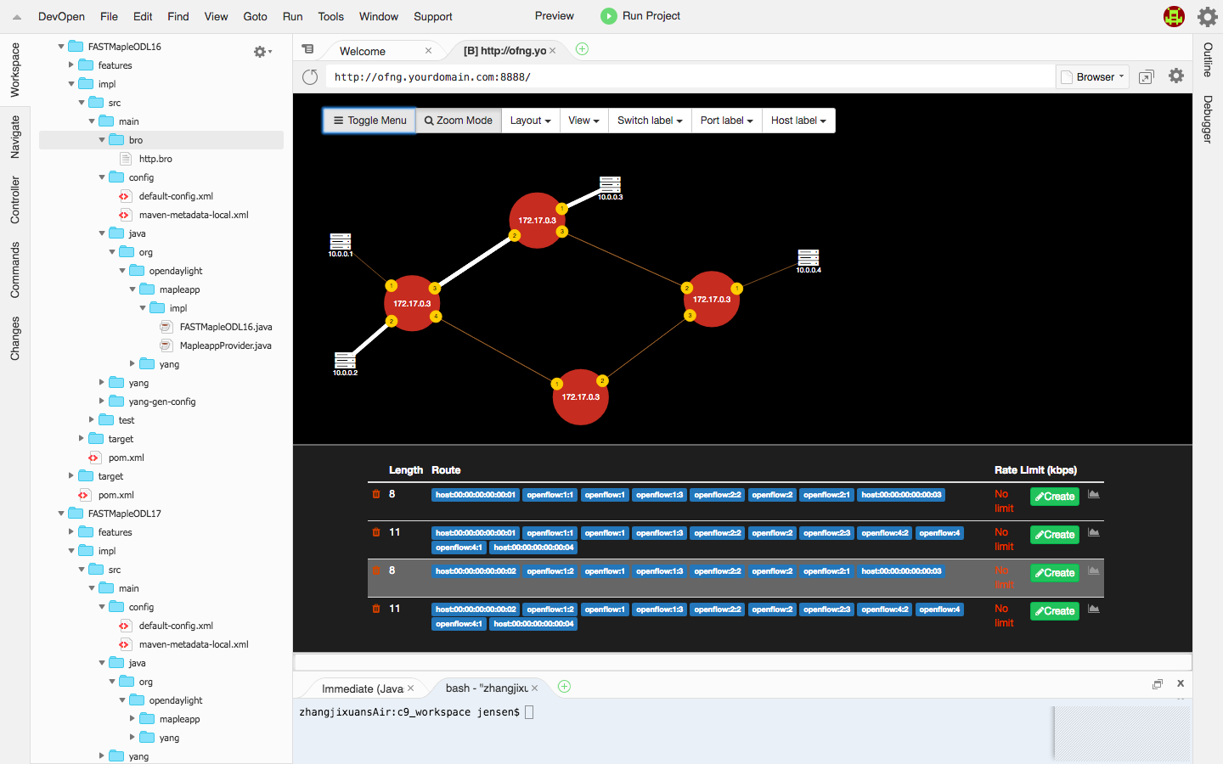
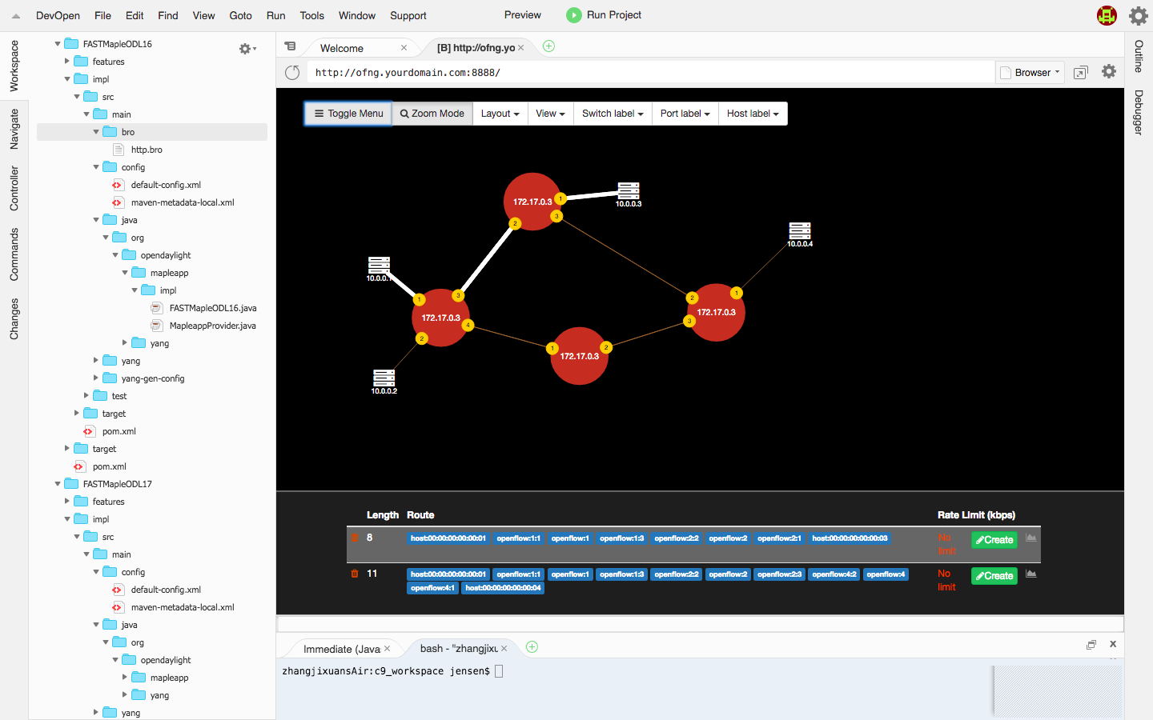
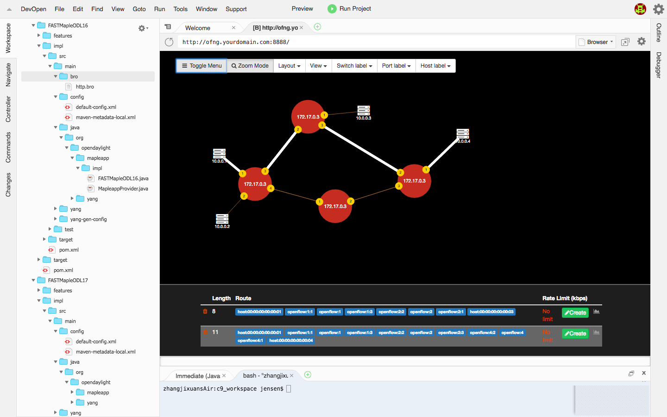
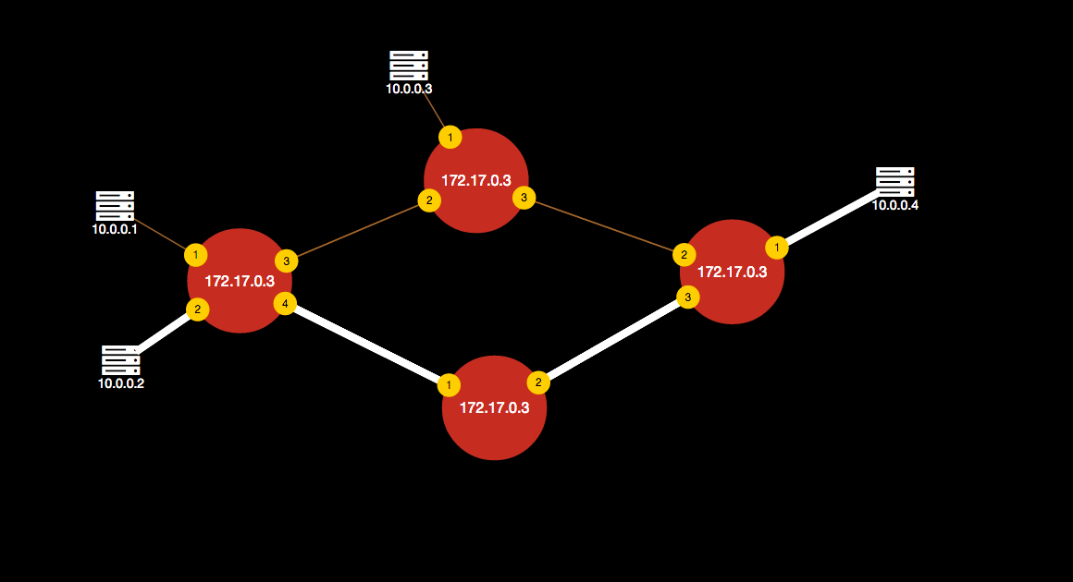
DEMO(Realizing Super SDN Programming using OpenFlow & Bro)
http.bro
MapleApp.java
Step of Demo（Firstly, Start an HTTP server at the Server ）:
Controller
1:IDE writes MapleApp and Bro programs
Bro
Set default datapath:S1->S2->S4, Make Bro can get http information.
S2
2:IDE deploys MapleApp and Bro programs
Client1
S1
S4
Server
3:Client1 sends a request for a word file at the Server
Client2
S3
4:Client2 sends a request for an mp4 file at the Server
When user want to get different type file, Bro can got L7 info->controller. FAST can trace data dependence and re-execute Maple->get new path to send different file.
It’s work!
Notes:
Demo explain:
1. WebIDE can quick programming with Maple and FAST.
2. Each and every packet can execute by MapleAPP.
3. Maple can handle cross-layer programming. Such as : SrcIP in L2, GetUri in L7.
4. MAple can completely south-bound agnostic.
5. FAST can automatic trace data dependence, If any change, FAST can re-execute the MapleApp.
6.Controller can deploy all flow rule and switch flow table.

Slide 8
Summary
Powerful state of the art, generic tools to substantially simplify SDN programming
Before
Now
Manual odl programming
WebIDE
Complex, manual maven programming
Web-based automatic generation of projects
Programmer focuses only on policy decision.
Low level, limited programming model
Maple
Low-level, complex, limited (L2-L4) OpenFlow rule programming
Programmer can define only at flow level
Specific access control allowing only hosts partition
High-level, completely south-bound agnostic, cross-layer (L2-L7) programming
Programmer sees (logically) each and every packet
Integrated access control supporting per-user or role based programming
Raw data store
FAST
Complex, manual tracking of execution dependency
Manual cleanup, re-execute
Designed directly on raw data store
Automatic execution dependency tracking
Automatic cleanup, re-execution (intent ++)
Host generic network functions

Slide 9

Thank You

